Slide 1
Course 6
Software Quality Factors in detail
Integrity / Security / Safety

Slide 2
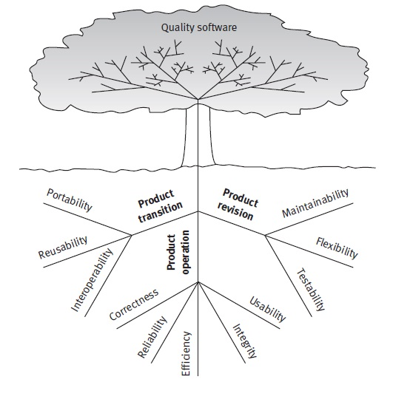

Slide 3
Safety
Security
Integrity

Slide 4
Integrity vs. Security vs. Safety
Integrity
Extent to which access to software or data by unauthorized persons can be controlled [McCall].
Security
Protect data and resources contained in and controlled by the software
Safety
Freedom from software hazards
Elimination of conditions hazardous to operation as a result of errors in process control software [Deutsch & Willis model]
Internal consistency or lack of corruption in electronic data and at the human level
Prevents unauthorized or improper access & allow proper access
Risk for privacy
Risk for human lives or environment
Integrity = ability to withstand attacks to its security
Safety requires security: when unauthorized access results in an incident
Security ⊆ safety – when any unauthorized access is considered an accident

Slide 5
Integrity [McCall]
Criteria:
Access control
Access audit
Measured in: analysis, design, implementation
Impact in operation

Slide 6
Access Control
Access Audit
User access control (ID, password)
Database access control (authorization table, privacy)
Memory protection across tasks (mobile app, partitions)
Support for recording and reporting access
Support for awareness of access violation

Slide 7
Security
Remarks:
Weakest link
Environment dependable
Approach - Risk analysis:
Identify risks
Evaluate ways to protect against it
Detect security vulnerabilities
Notes:
1. Secure one part, if another part has a security hole than is worthless
2. Secure in an environ. (behind firewall), insecure in another

Slide 8
Security vulnerabilities
Buffer overflow / overrun:
write outside the limits of data structure
C/C++
Race conditions: an atomic operation is performed in 2 steps
File access permission
API functions – insecure interfaces
In C++:
strcopy
strcat
getwd
Notes:
2.Check permission –non privileged user and assume it for further operations
3. Original insecured functions, added only afterwards

Slide 9
Security vulnerabilities
Untrusted input: accept and use data from untrusted sources
Result verification:
function and system calls fail
Traceroute / tracert (Windows) - track the route of internet packages
Data and privilege leakage
Notes:
5. – return error code. If not checked vulnerable

Slide 10
Solutions
Java approach:
Associating permissions with code and checking them – security manager
Tools:
Flawfinder – C/C++ code
Looking for functions known for security vulnerabilities associations
http://www.dwheeler.com/flawfinder/
Splint – C code
Checks for security vulnerabilities and coding mistakes
Parse C code
Allows code annotation
http://lclint.cs.virginia.edu/
Notes:
Java 2 platform

Slide 11
OWASP Top 10 Security Risks – 2017 / 2013
Injection
Broken Authentication and session management
Sensitive Data Exposure (former 6)
XML external entities (new)
Broken access control (new)
Security misconfiguration (former 8)
Cross-Site Scripting
Insecure deserialization (new)
Using components with known vulnerability
Insufficient Logging & Monitoring
OWASP = Open Web Application Security Project
www.owasp.org

Slide 12
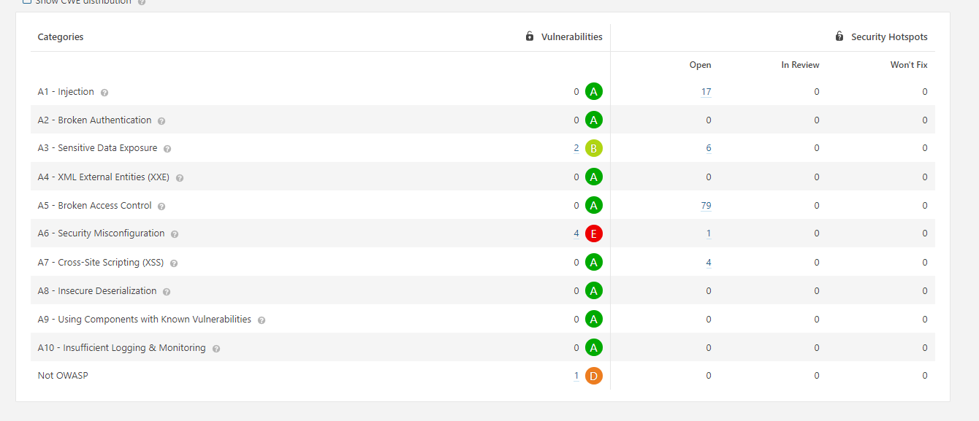

Slide 13
New
OWASP Mobile Security Project – top 10 (2016)

Slide 14
Software Security Measurement and Assurance
CWE – Common Weakness Enumeration cwe.mitre.org
Community-developed formal list of common software weaknesses
CERT – Computer Emergency Center – Carnegie Melon Univ.
http://www.cert.org/
Software security assurance
Security measurements and analysis
Frameworks and protocols
Methods and tools
IBM, Microsoft, RedHat, Apple,…

Slide 15
CERT Risk analysis
2 approaches:
Tactical
risk = probability that an event will lead to a negative consequence or a loss
Goal: evaluate systems components for potential failure
Systemic
Risk = probability of mission failure

Slide 16
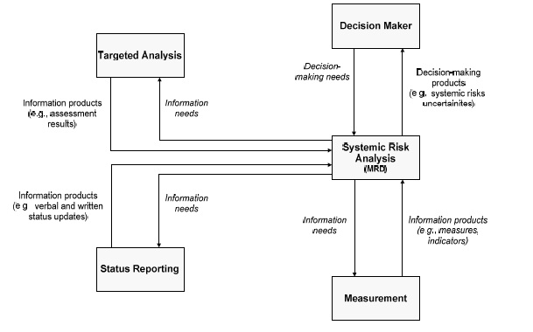
CERT - IMAF
Integrated Measurement and Analysis Framework
Application in software security
[C. Alberts, J. Allen, R. Stoddard – Risk-Based Measurement and Analysis: Application to Software Security]

Slide 17
Case study Microsoft – security checklists [M. Howard, D. LeBlanc – Writing Secure Code]
Designer
Developer
General
Web & database-specific
RPC
ActiveX, COM and DCOM
Crypto and Secret Management
Managed Code
Tester

Slide 18
Snapshot Designer’s Security Checklist
Person responsible for bug tracking (BugTrack - http://www.bugtrack.net/)
Competitor’s vulnerabilities analyzed
Past vulnerabilities in previous versions analyzed
Safe-for-scripting controls reviewed
Sample code reviewed for security issues
Default install is secure
Threat models complete for design phase
Security failures logged for later analysis
. . .

Slide 19
Safety
Freedom of conditions that can cause death, injury, damage, loss, environmental harm
Important in safe critical systems
Harm severity – classification:
Catastrophic
Critical (severe)
Major
Minor
No effect (negligible)

Slide 20
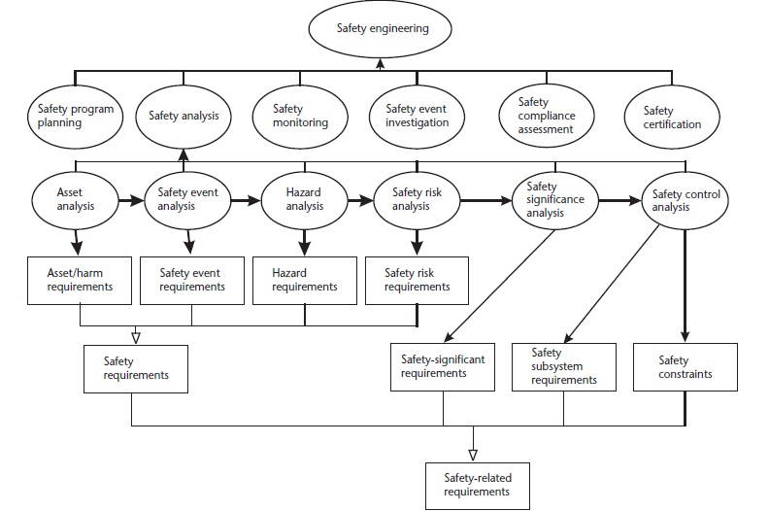
System Safety Plan [Firesmith, D., Engineering Safety-Related Requirements for Software-Intensive Systems]

Slide 21
1228-1994 - IEEE Standard for Software Safety Plans
Software Safety Analysis Procedures – USA, 2014

